Slide 1
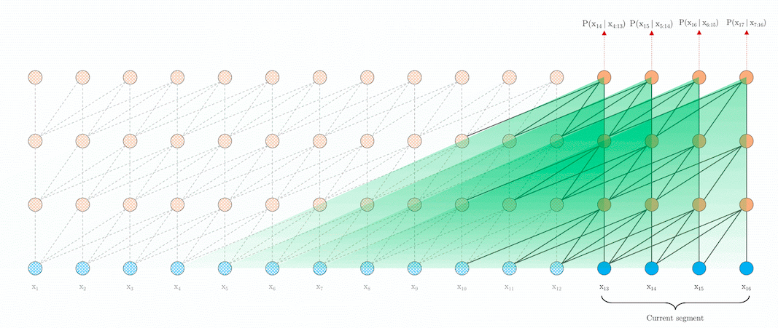
Transformers-XL
Florian Goebels TDLS 21 Feb 2019

Slide 2
Problem statement
Attention can only deal with fixed-length context
Those fixed length are created by chunking up sentences causing context fragmentation
Solution introduce recurrence into deep self-attention networks

Slide 3
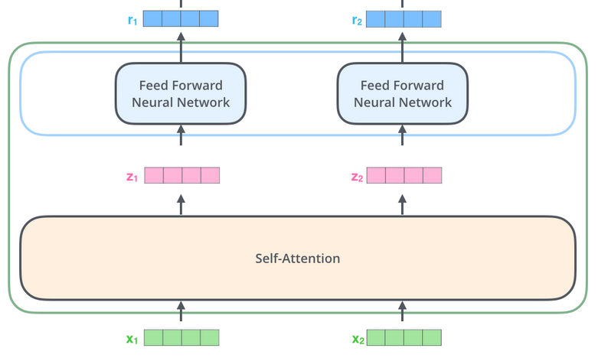
Self attention revisited

Slide 4
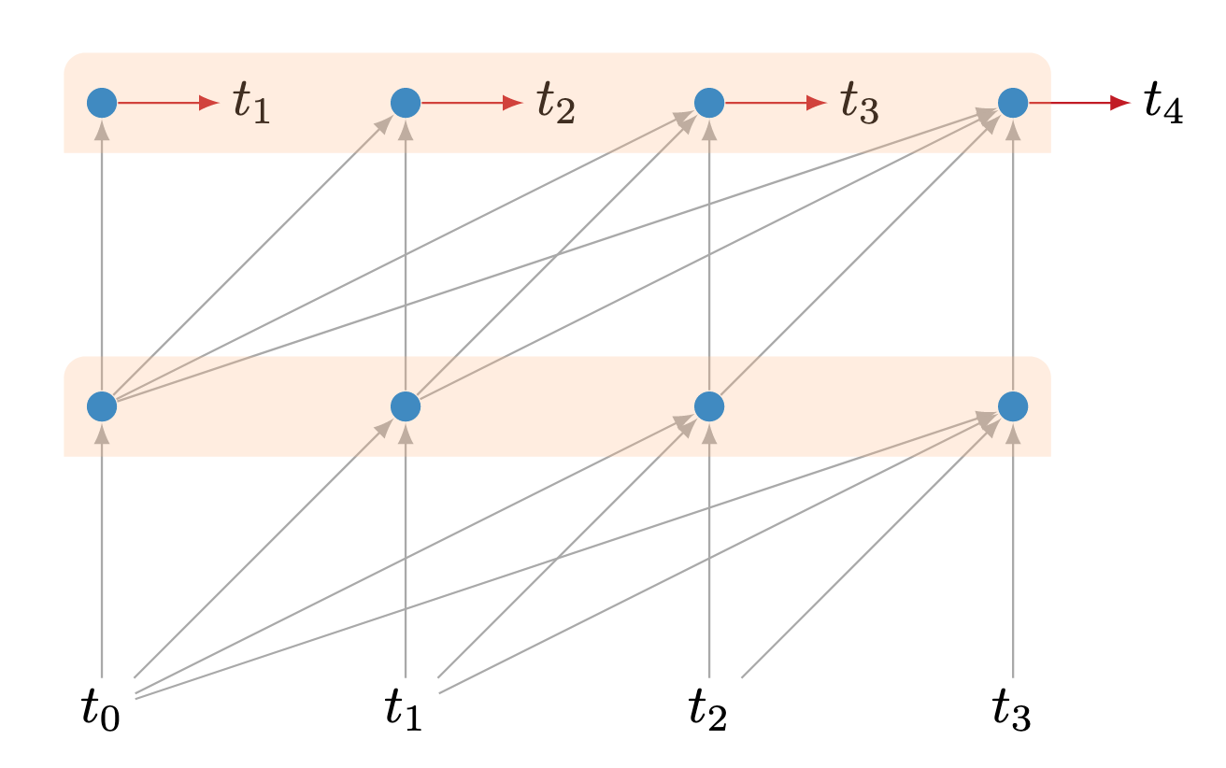
Vanilla training

Slide 5
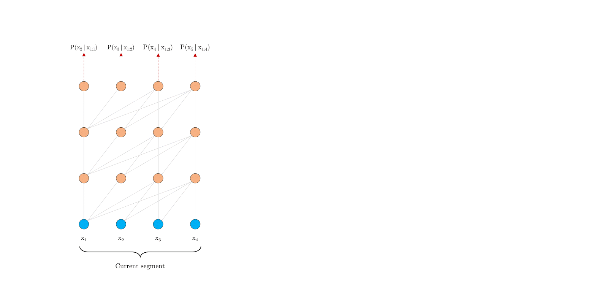
Vanilla training

Slide 6
Vanilla training
Information never flows across segments
largest possible dependency is bound by sequence length
longer sentences/sequences get split up causing context fragmentation

Slide 7
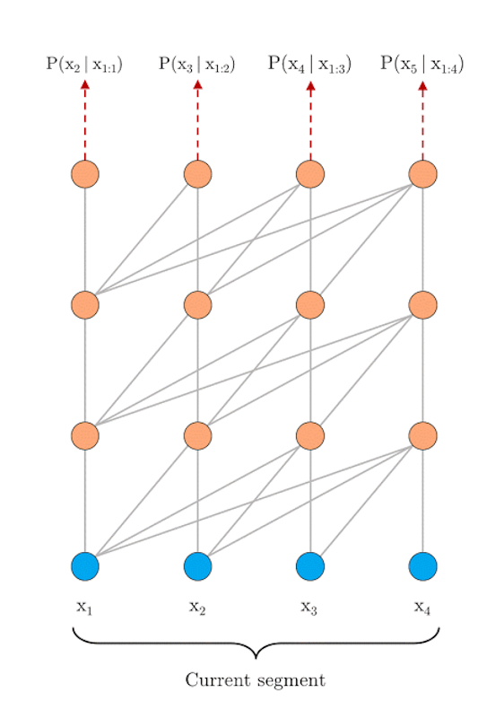
transformer-XL training

Slide 8
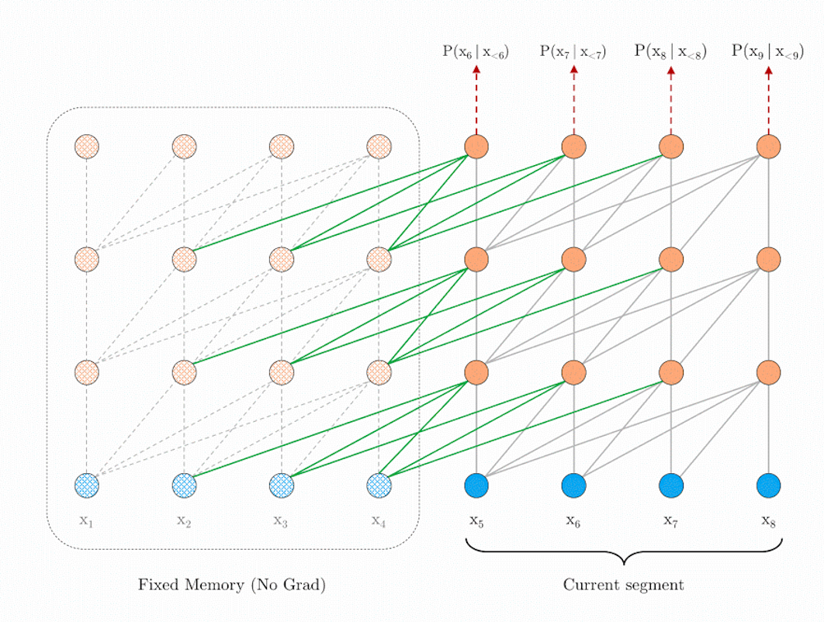
transformer-XL training

Slide 9
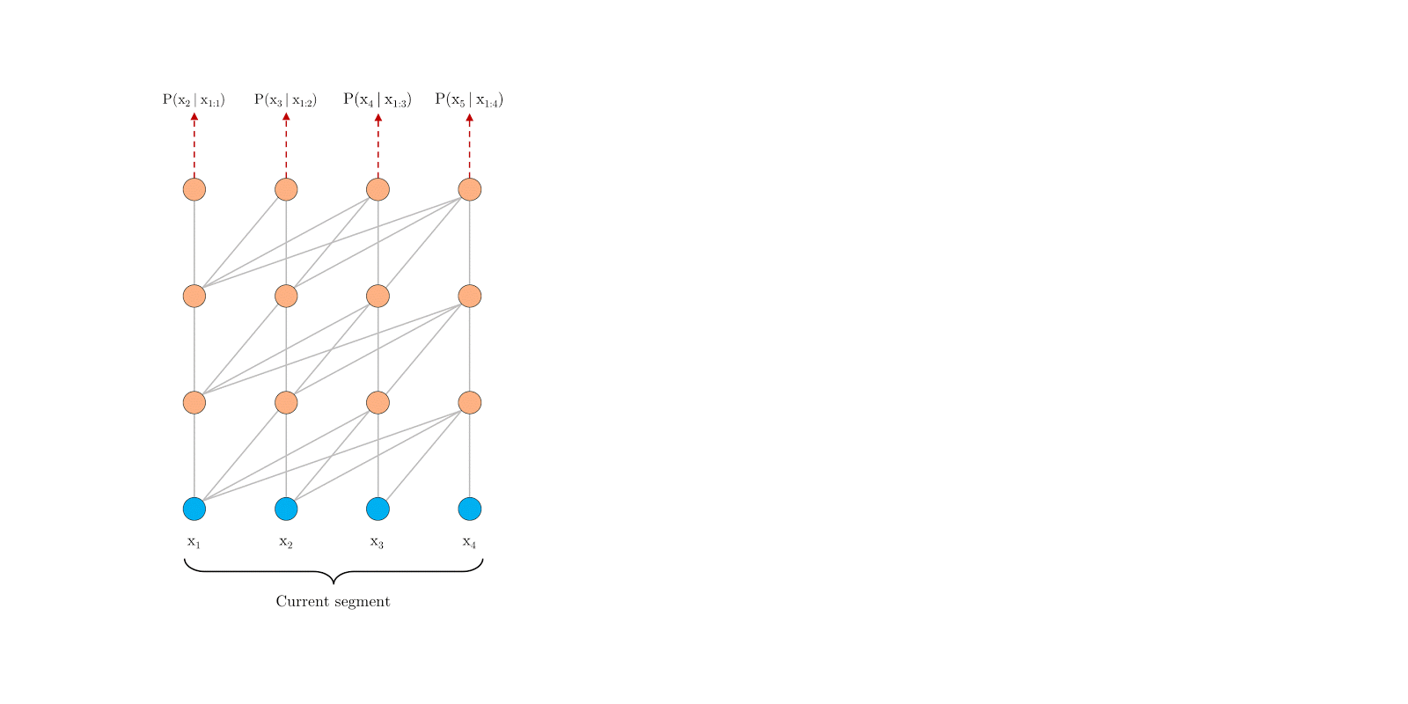
transformer-XL training

Slide 10
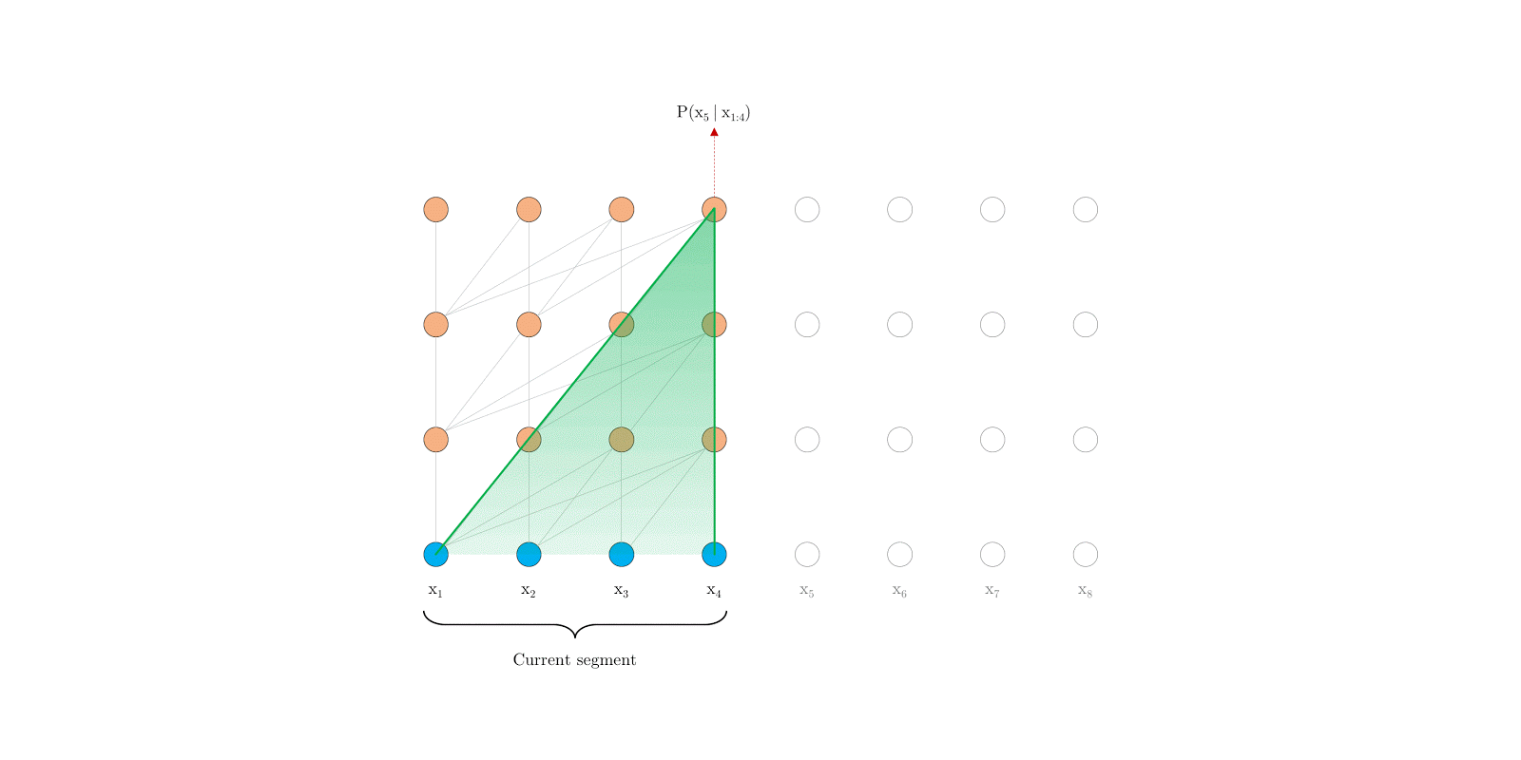
Vanilla prediction

Slide 11
Vanilla prediction
Consumes one segment at a time, but only does one prediction
Relieves context fragmentation
Extremely expensive

Slide 12
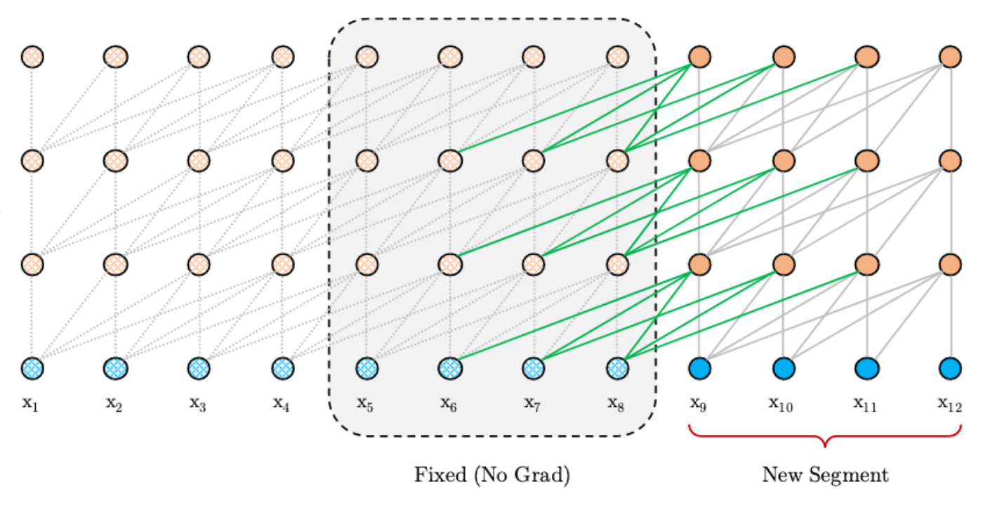
Transformer-XL prediction

Slide 13
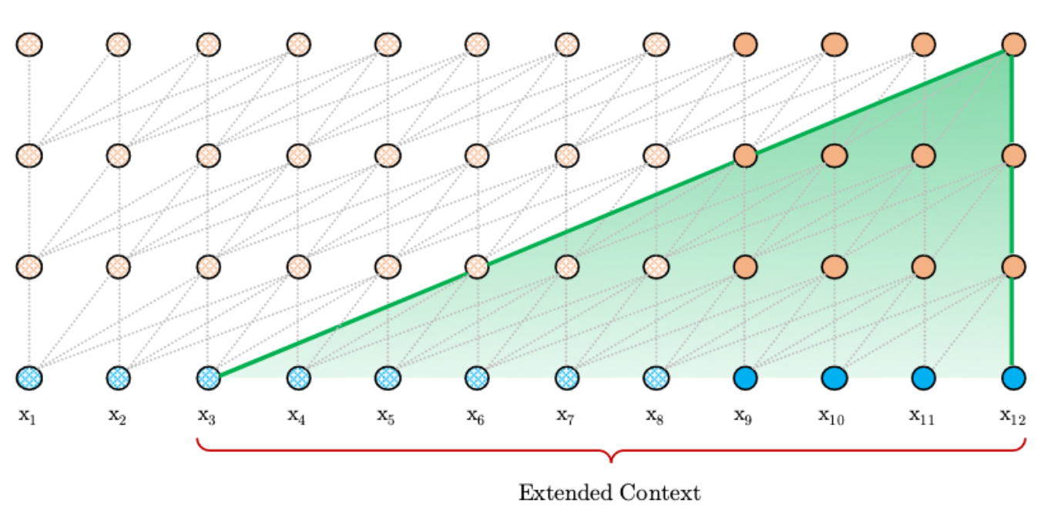
Transformer-XL prediction

Slide 14
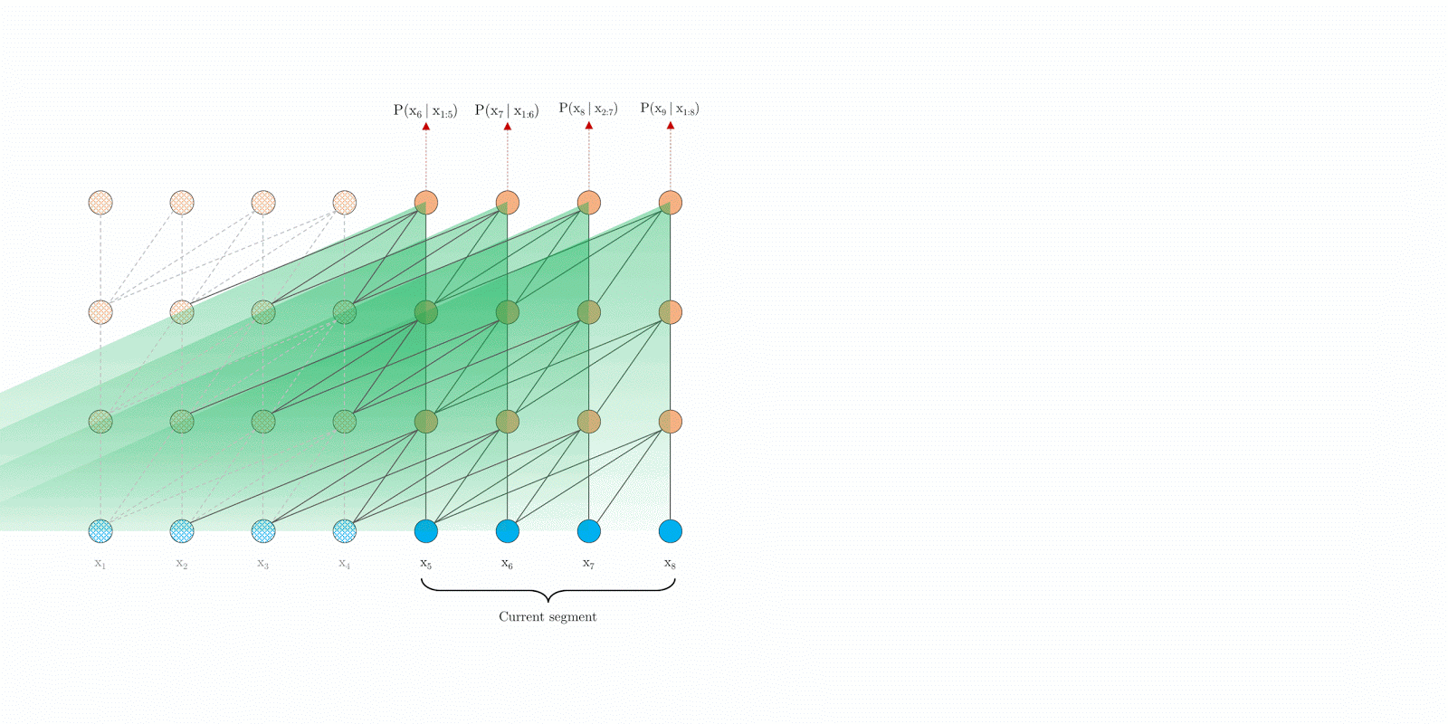
Transformer-XL prediction

Slide 15
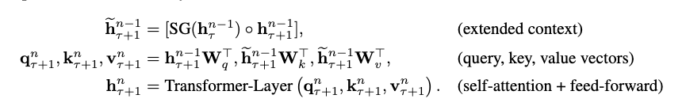
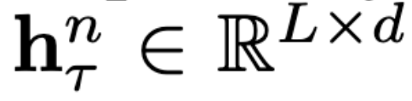
In formula
nth layer hidden state for segment τ

Slide 16
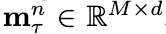
Using memory
Cache predefined length-M old hidden:
Training M sequence length
Evaluation M is multiple of sequence length

Slide 17
Position wise embeddings

Slide 18

Vanilla embeddings

Slide 19
[0, 1, 2, 3]
[0, 1, 2, 3]

Slide 20
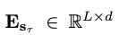
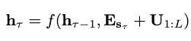
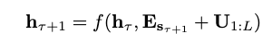
Word embeddings
Position wise embeddings

Slide 21
What to change?

Slide 22
Relative-position wise embeddings

Slide 23
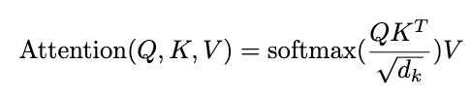
Original self attention in other words

Slide 24
Extend Self attention
Extend Qi*Ki by four terms:
Content Weight: the original score without the addition of the original positional encoding of course
Positional bias with respect to the current content (Qi). Sinusoidal function that receives the distance between tokens (e.g. i-j).
A learned global content bias - vector for adjusting key importance
A learned global position bias

Slide 25
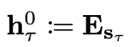
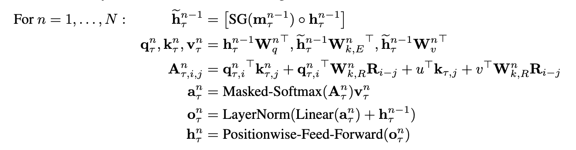
Transformer-XL
Content based
Relative position
embedding
Global content bias
Location based
Global position bias

Slide 26
Results

Slide 27
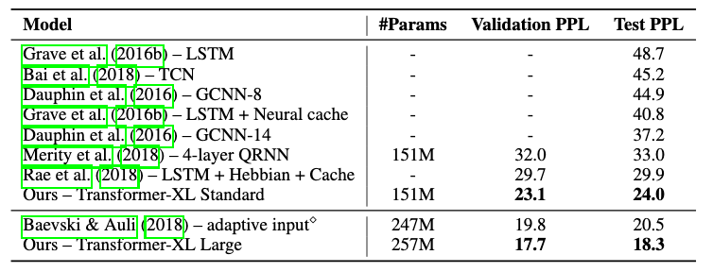
WikiText-103
Attention Length 384 training, 1600 test
103M training tokens from 28k articles, with 3.6k tokens per article

Slide 28
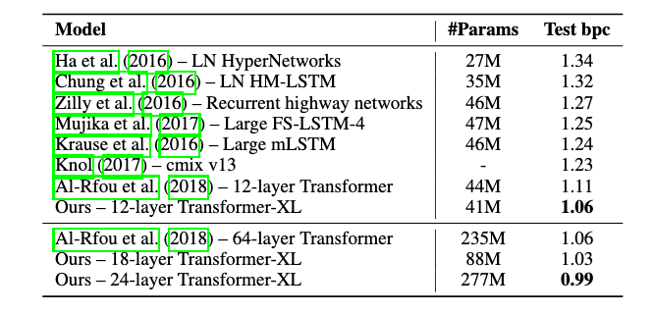
enwiki8
Attention Length 784 training, 3200 test

Slide 29
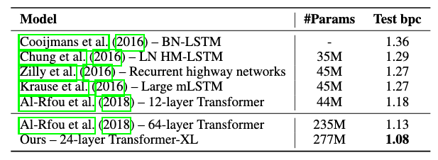
text8
Attention Length 784 training, 3200 test

Slide 30
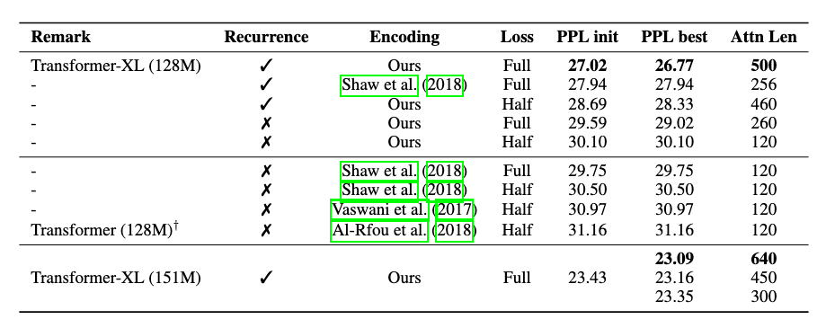
Ablation study
WikiText-103

Slide 31
Summary
Enable language modelling with self-attention architecture beyond a fixed length context. (Recurrence in purely self-attentive model)
can learn longer dependency
80% and 450% more than RNN and vanilla transformer
1,800 times faster than vanilla transformer

Slide 32
Attention Layers

Slide 33
Attention layers
Visualize attentions from for model on WikiText-103
16 10-head transformer layers and memory length of 640

Slide 34
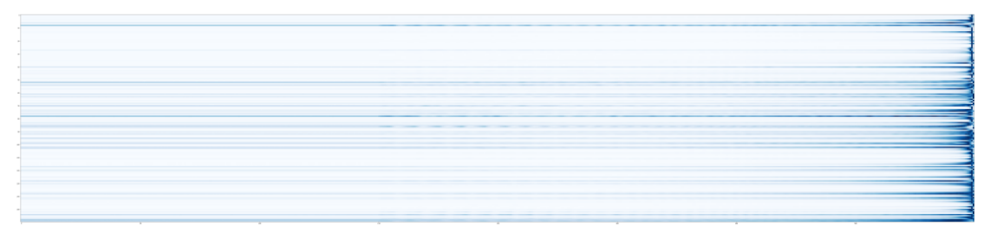
Attention layers
Row attention head; Col relative locations (every 10 head 1 layer)
Average attention over all tokens in the validation set
trend focus nearby tokens (some exceptions)

Slide 35
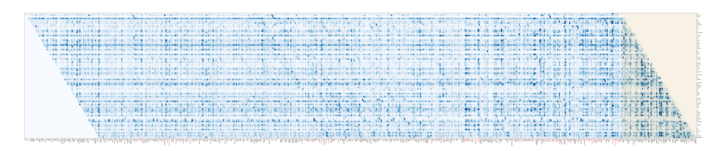
Attention layers
Head 8 Layer 1:
Uniform attention over entire memory span - screen entire memory span
Focus happens in higher-level layers

Slide 36
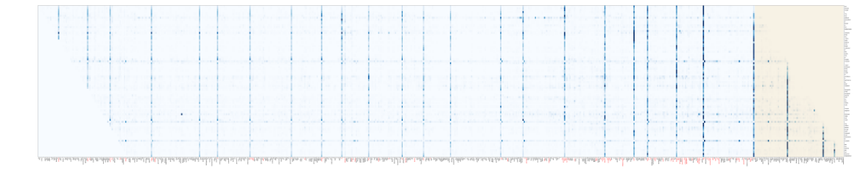
Attention layers
Head 78 Layer 8th Layer (mid lvl layer)
sparse attention as information accumulates, the network focus on some particular positions

Slide 37
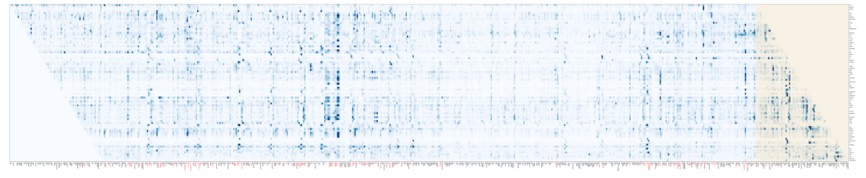
Attention layers
Head 158 Layer 16 (last layer)
each target location has it’s own distinct focus
differs from layer 78 where focus is shared
layer 1 few locations attend more

Slide 38
Thank you for your attention ;)
5 min break

Slide 39
Discussion points
Does the recurrence prevent fast/parallel training?
Perplexity is not a good comparison between models. What alternative test would you suggest.
Integrate auxiliary loss

Slide 40
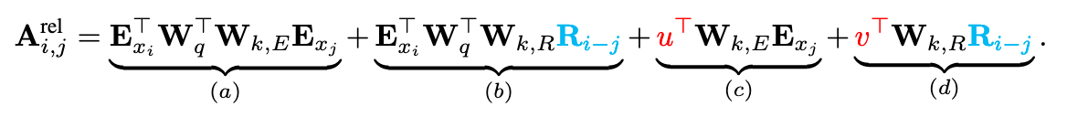
Position wise embeddings
It is enough to know the relative distance between i and j

Slide 41
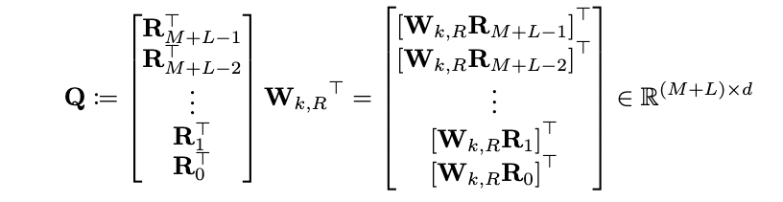
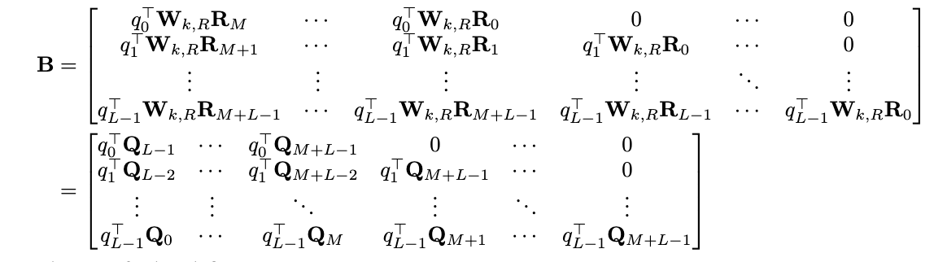
term b for all possible i,j stored in above L x (M + L) matrix

Slide 42
